Slide 1
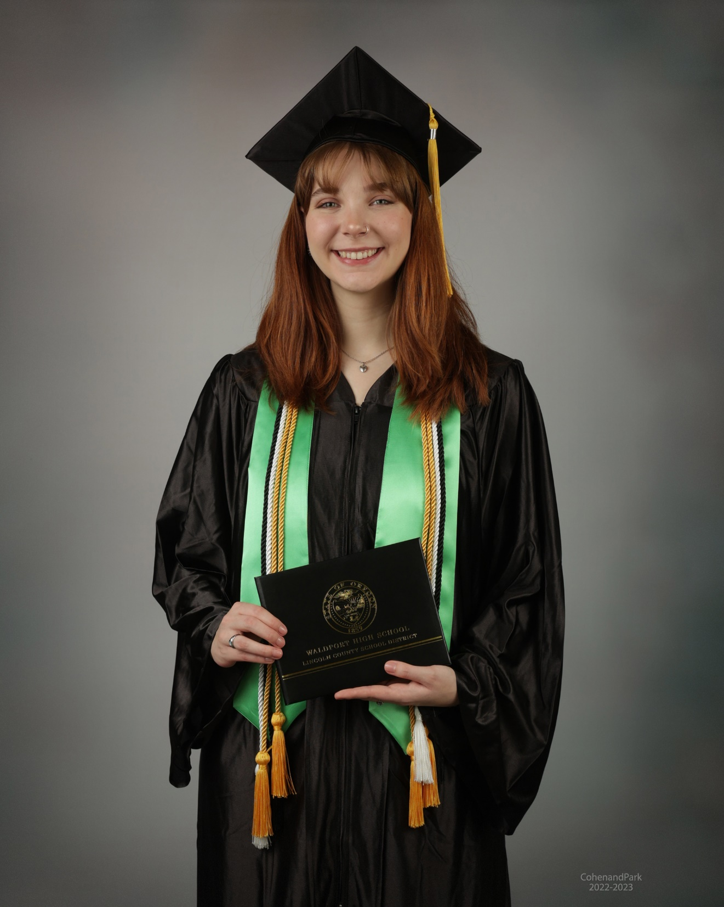
Abbey Anderson
Honors Diploma
Abbey plans to attend Portland State University to major in Theatre.

Slide 2
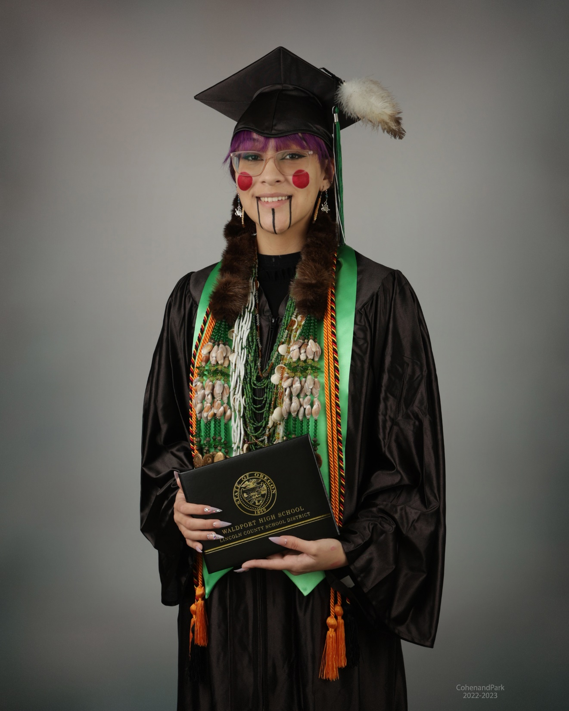
Shish Shee-Ne Aspria
Shey plans to enlist in the US Air Force or attend Western University to major in psychology to become a state trooper after graduation.

Slide 3
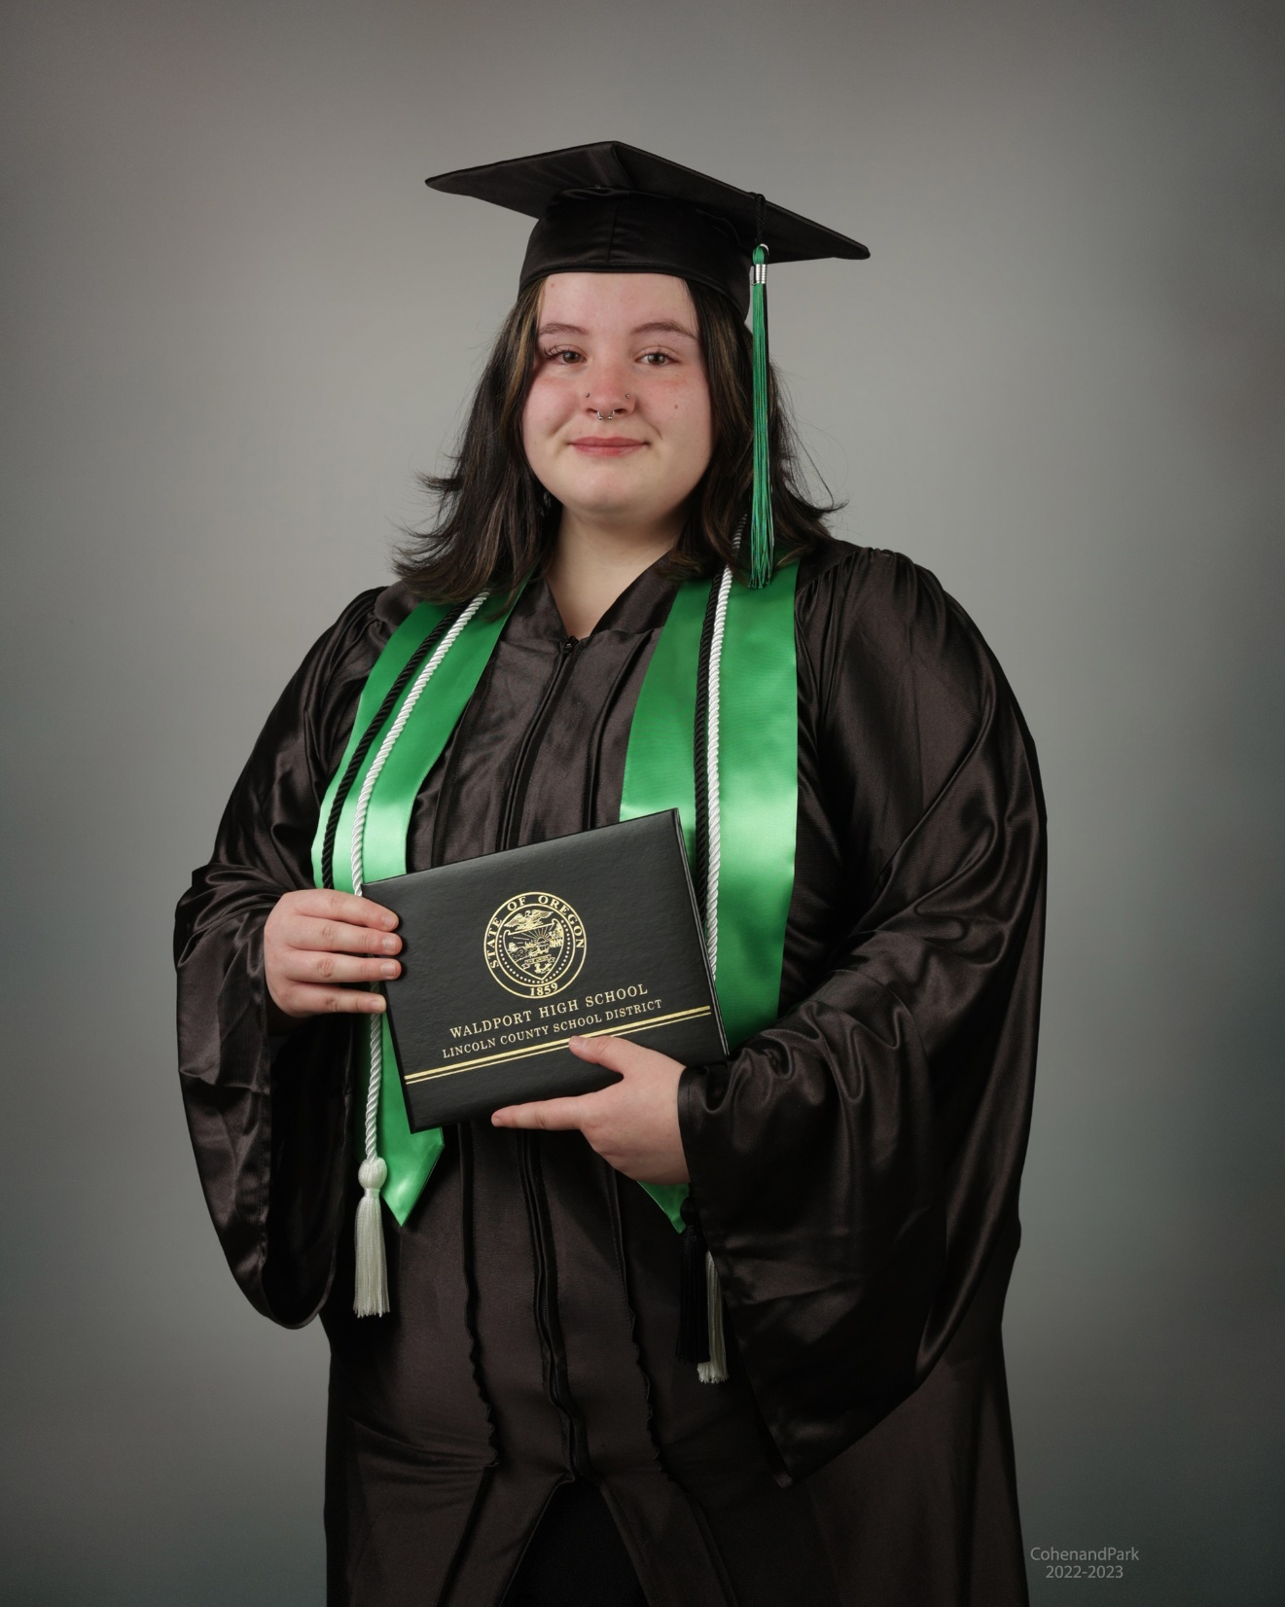
Lia Marie Babb
Lia will attend Portland State University as a Business major. She was awarded the PSU Tuition Free scholarship and the Oregon Opportunity Grant. Her long term goal is to start her own business.

Slide 4
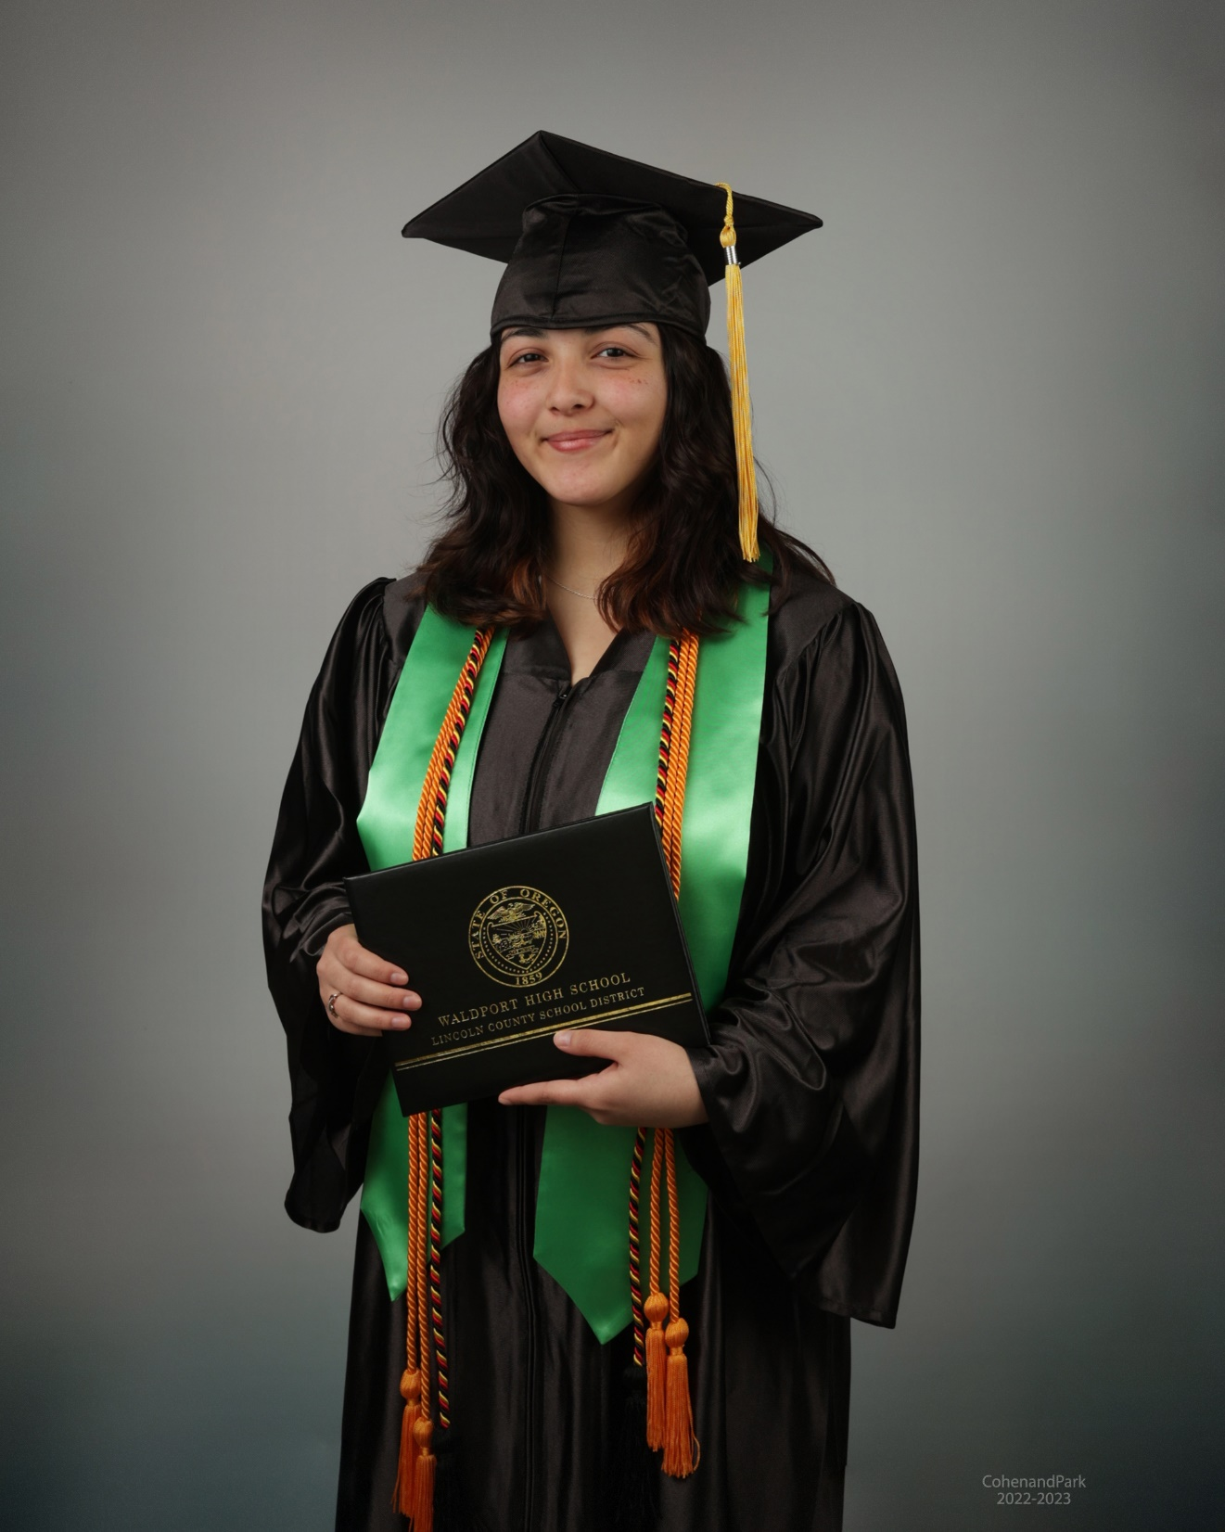
Lasha L. Banta
Honors Diploma
Lashae will begin her Nursing studies at Oregon Coast Community College after graduation. She will continue with OCCC and OHSU to earn her BSN.

Slide 5
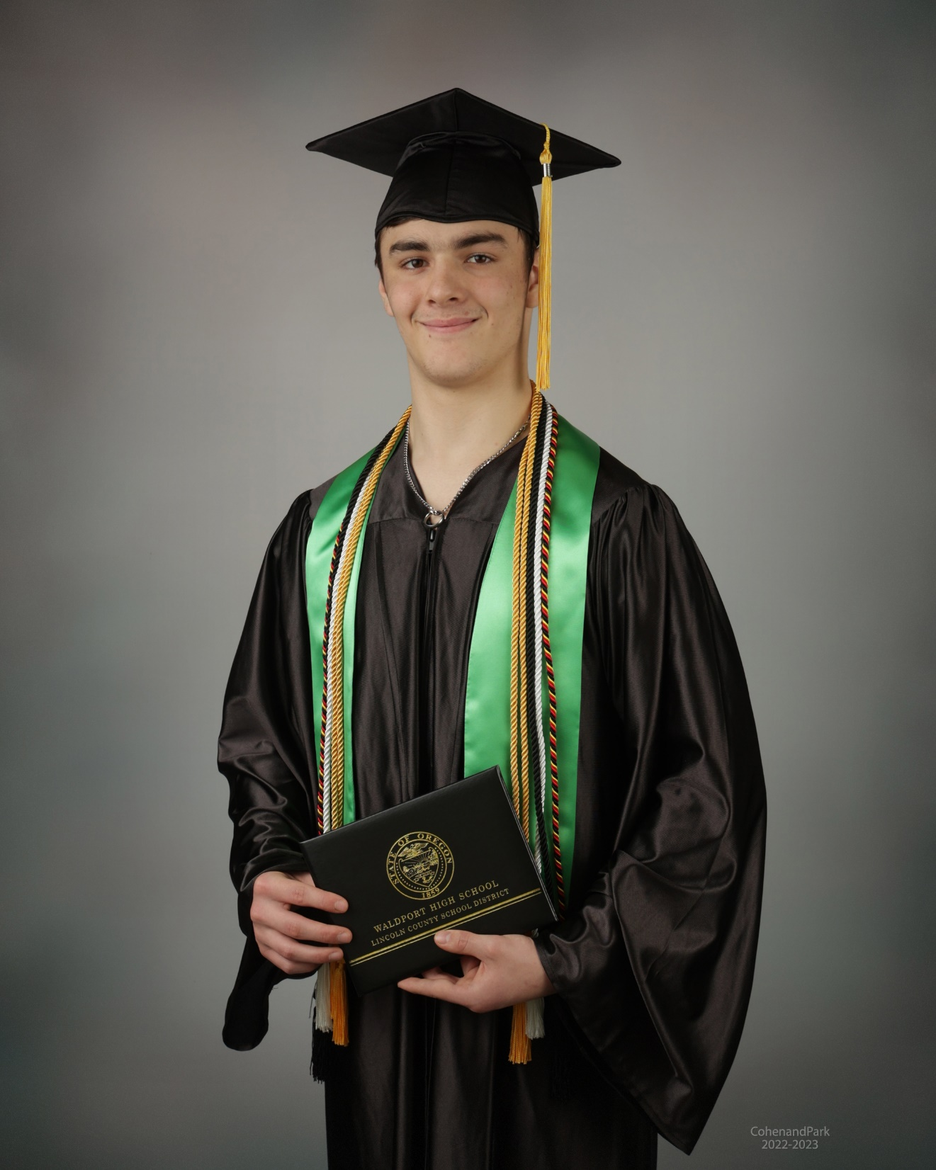
Josiah Burton-McGee
Honors Diploma
Joey will attend Oregon State University. He plans to major in pre-med/biology. His long term goal is to become a doctor.

Slide 6
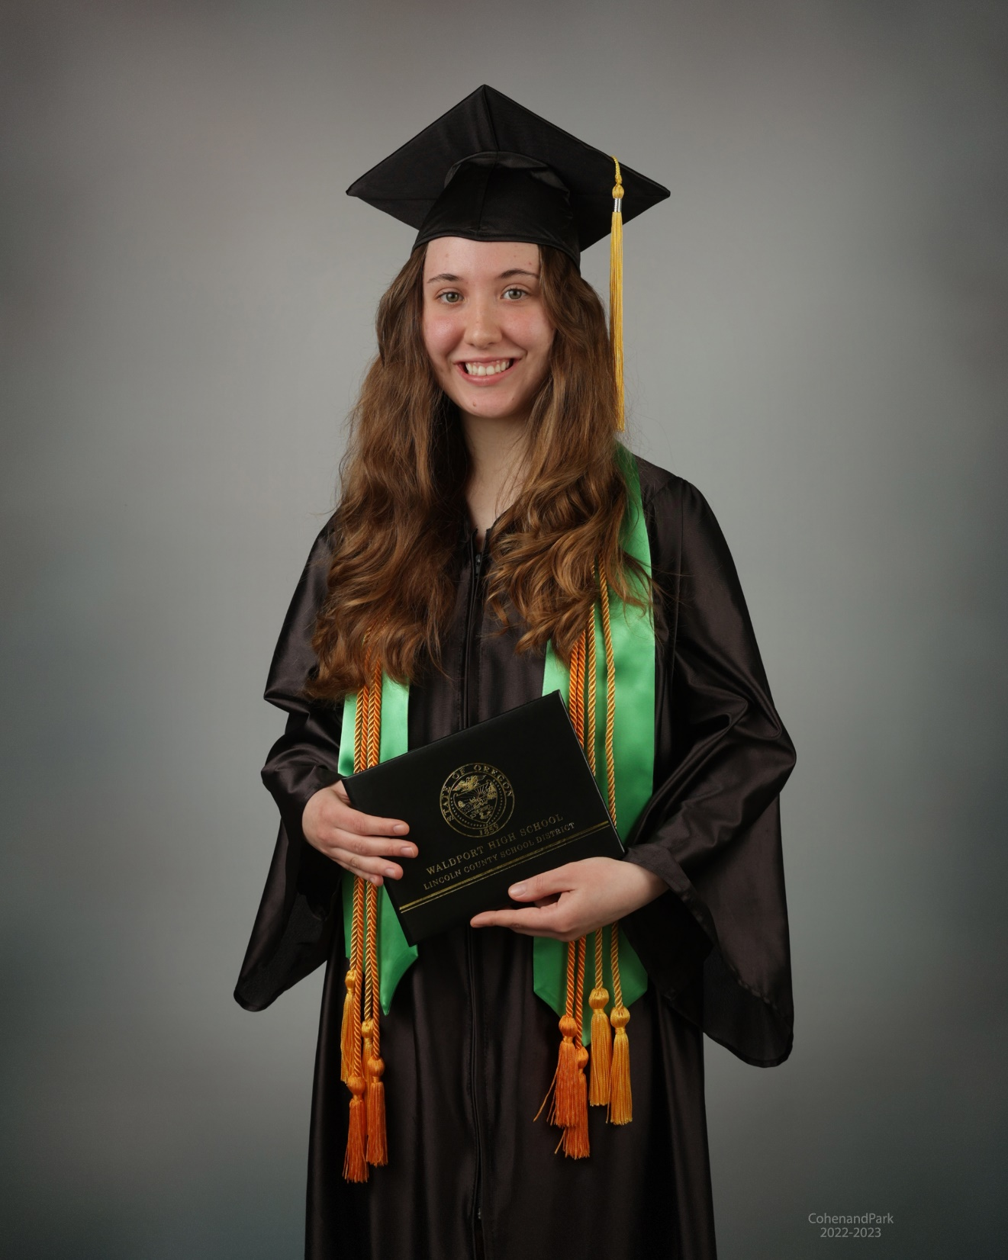
Iris Marie Donovan
Honors Diploma
Valedictorian
Iris plans to attend Oregon State University Honors College to major in Forestry.

Slide 7
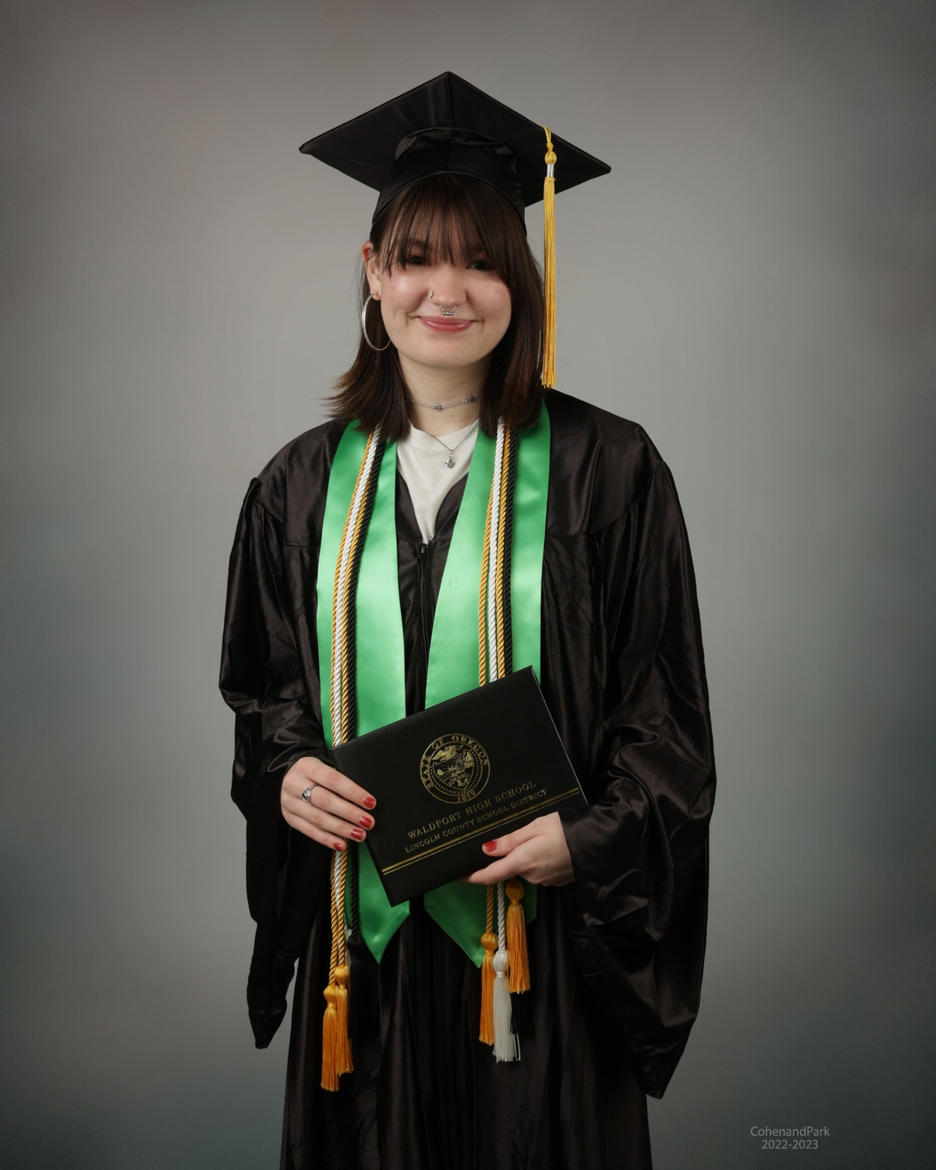
Sophia Marie Elizondo
Honors Diploma
Sophia will be attending Willamette University. She will major in Global Cultural Studies.

Slide 8
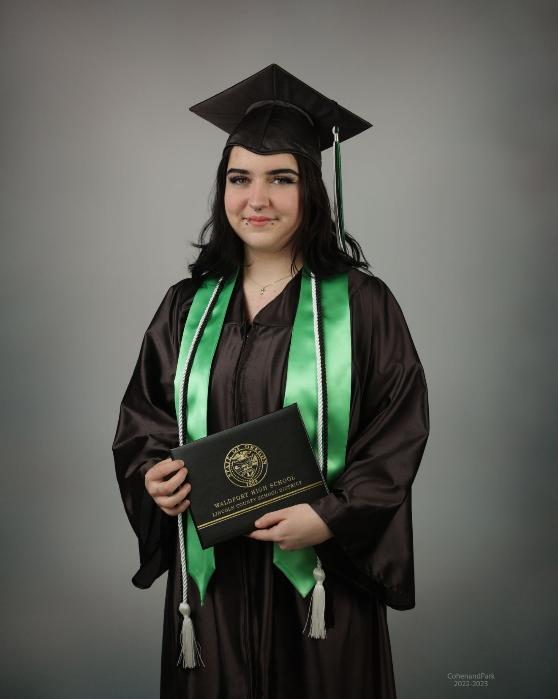
Rae’Lynn Florez
Rae’Lynn plans to attend Phagen Beauty School after graduation. Her long term goal is to open her own salon.

Slide 9
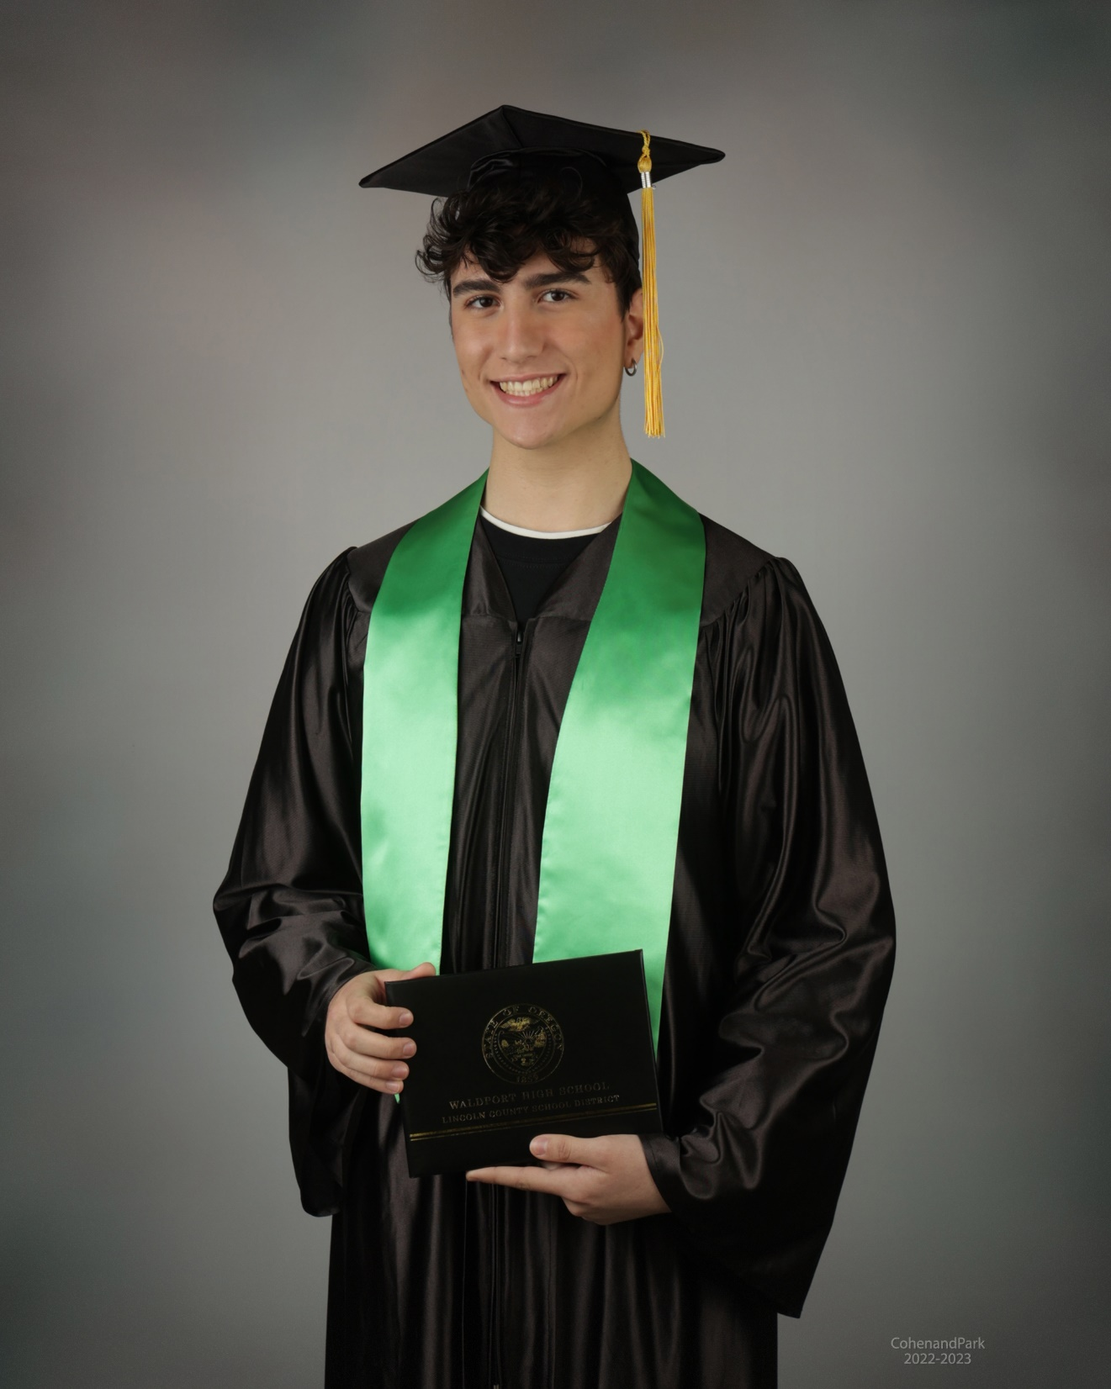
Claudio Galante
Exchange Student
Claudio will return to Italy to finish high school. He then plans to enroll in a University in Italy to further his education.

Slide 10
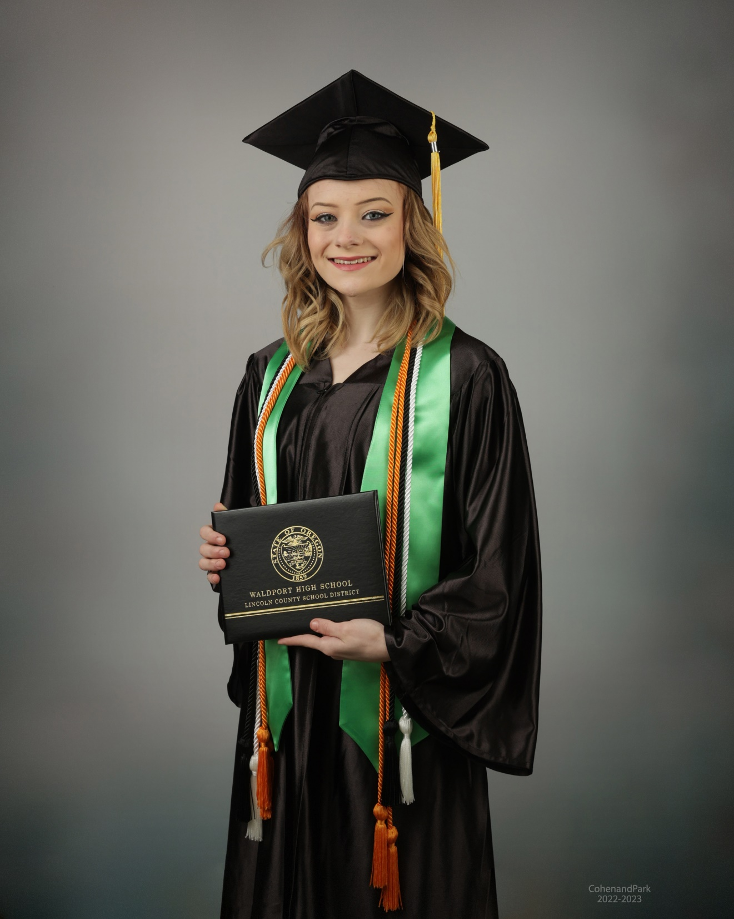
Gabrielle Nichole Glenn
Gabrielle plans to enroll at Oregon Coast Community College after graduation. She plans to continue her bachelor’s degree studies to major in Psychology. Her long term goal is to become a clinical psychologist.

Slide 11
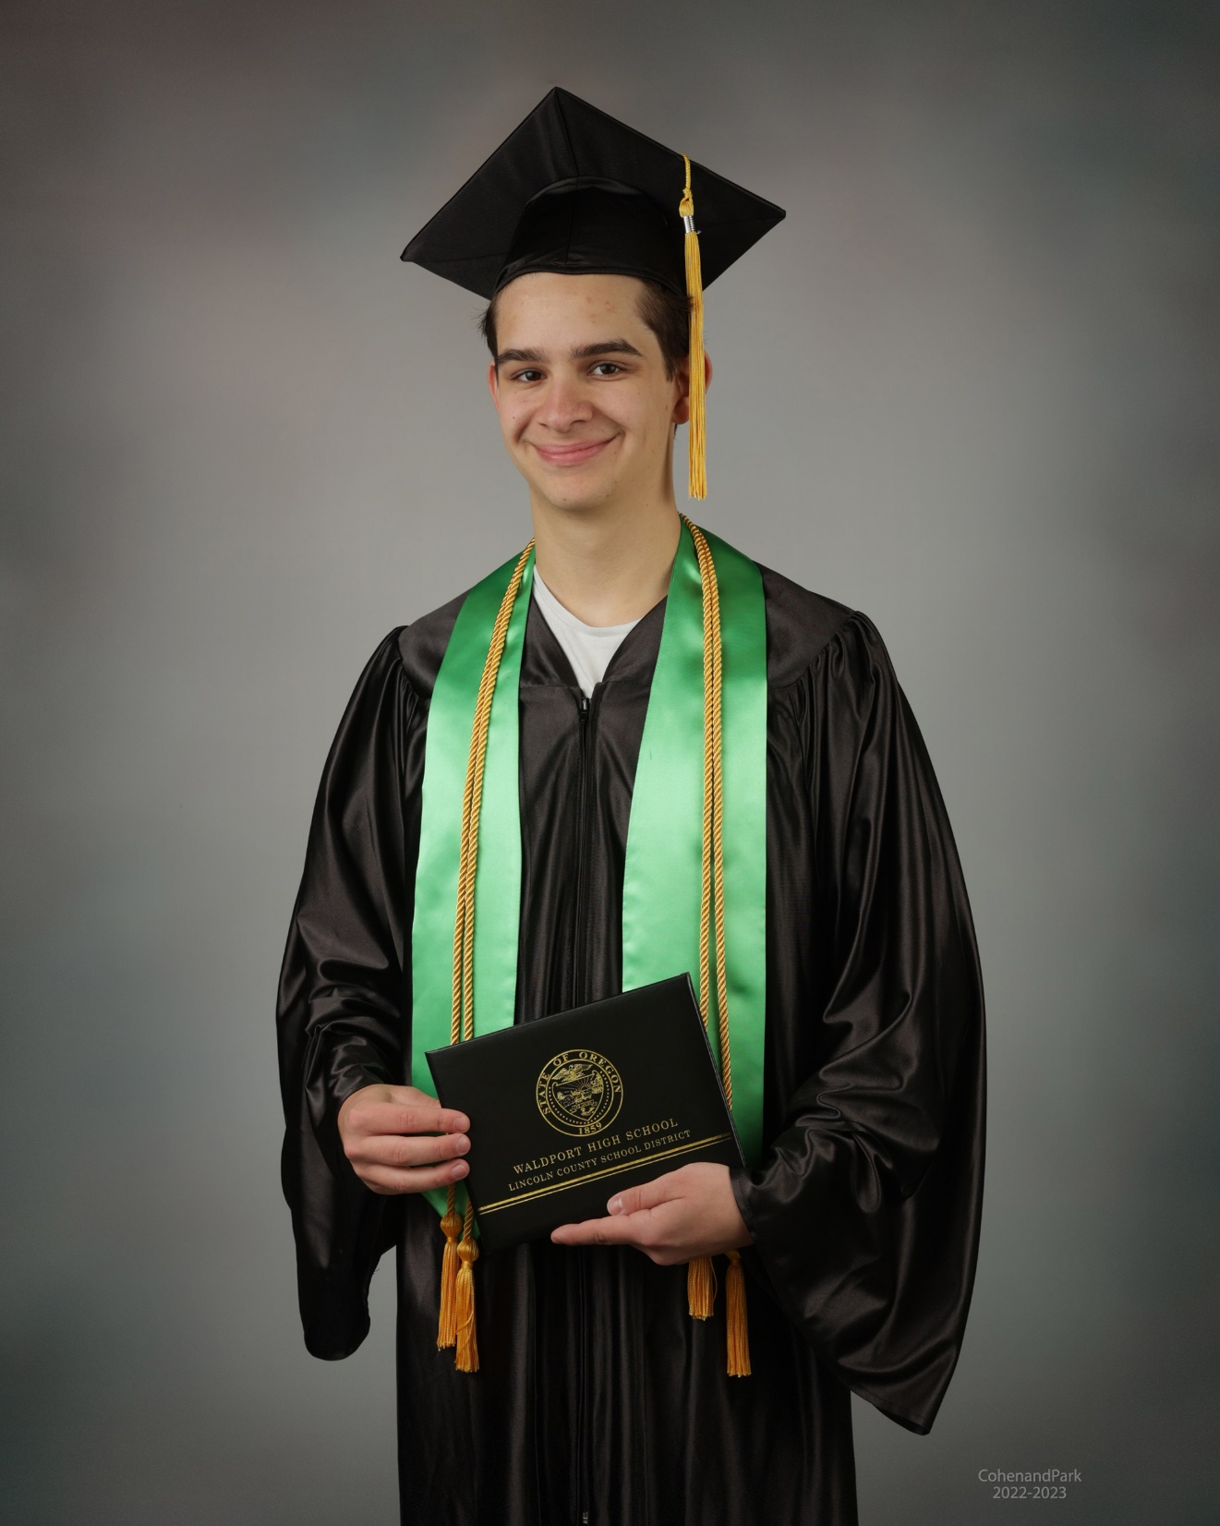
Andrew Gordon
Honors Diploma
Andrew will be attending Oregon State University after graduation. He will be majoring in Computer Science. His long term goal is to become a software engineer.

Slide 12
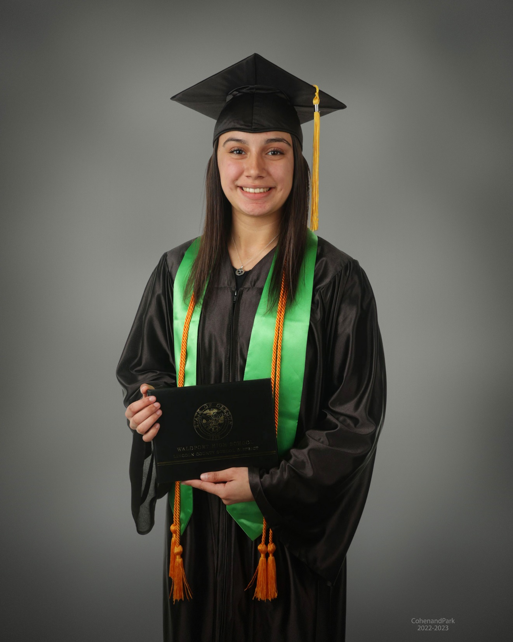
Elise Tatum Greene
Elise will be starting her forestry career after graduation. She
will be working with the Oregon Department of Forestry as a wildland firefighter.

Slide 13
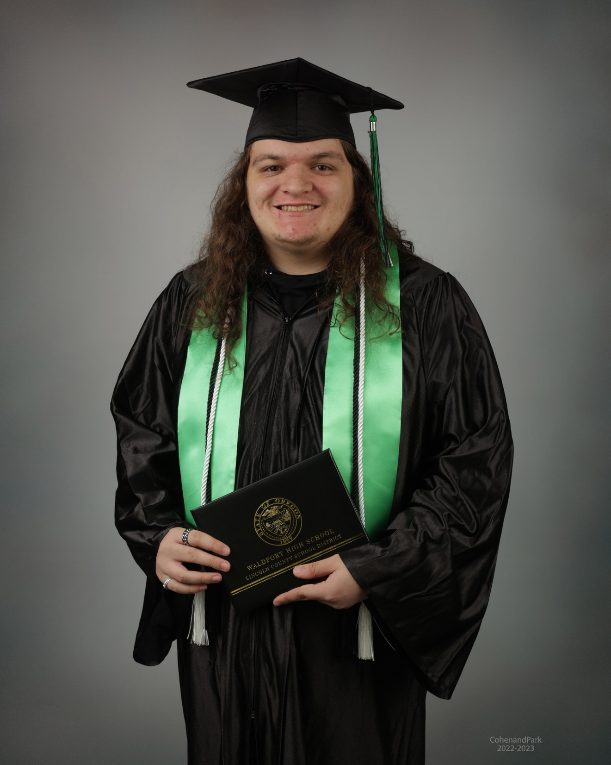
Tristen D. Holt
Tristen completed his graduation requirements in January of 2023! He is currently working.

Slide 14
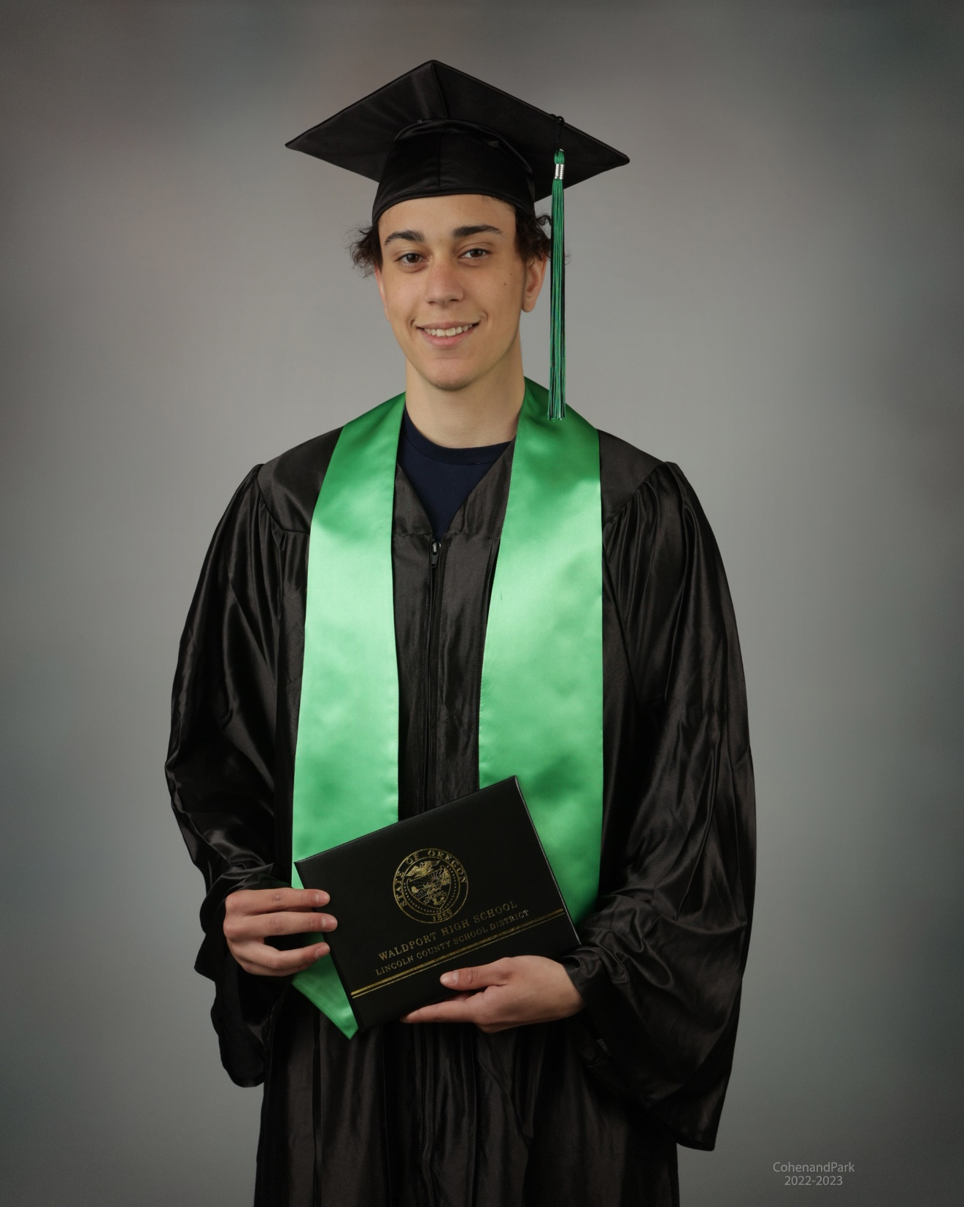
Justice Wilson Jackson
Justice is an entrepreneur. He plans to devote his full attention to his clothing business after graduation.

Slide 15
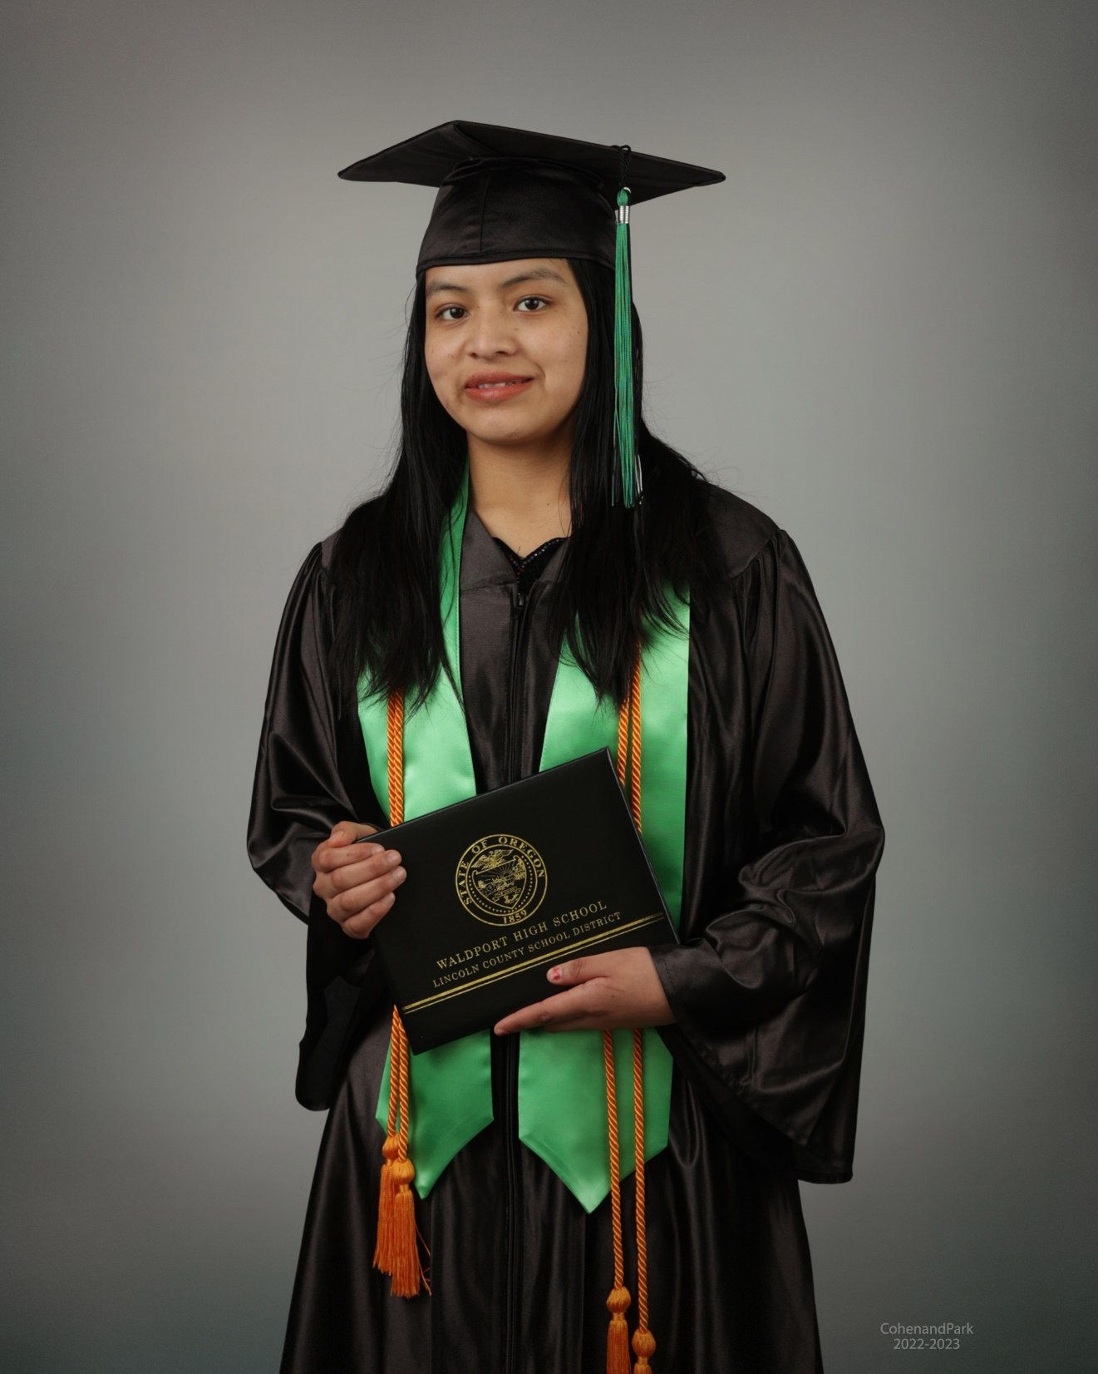
Santa Jeronimo-Matias
Santa is considering continuing her education at Oregon Coast Community College in a health profession field.

Slide 16
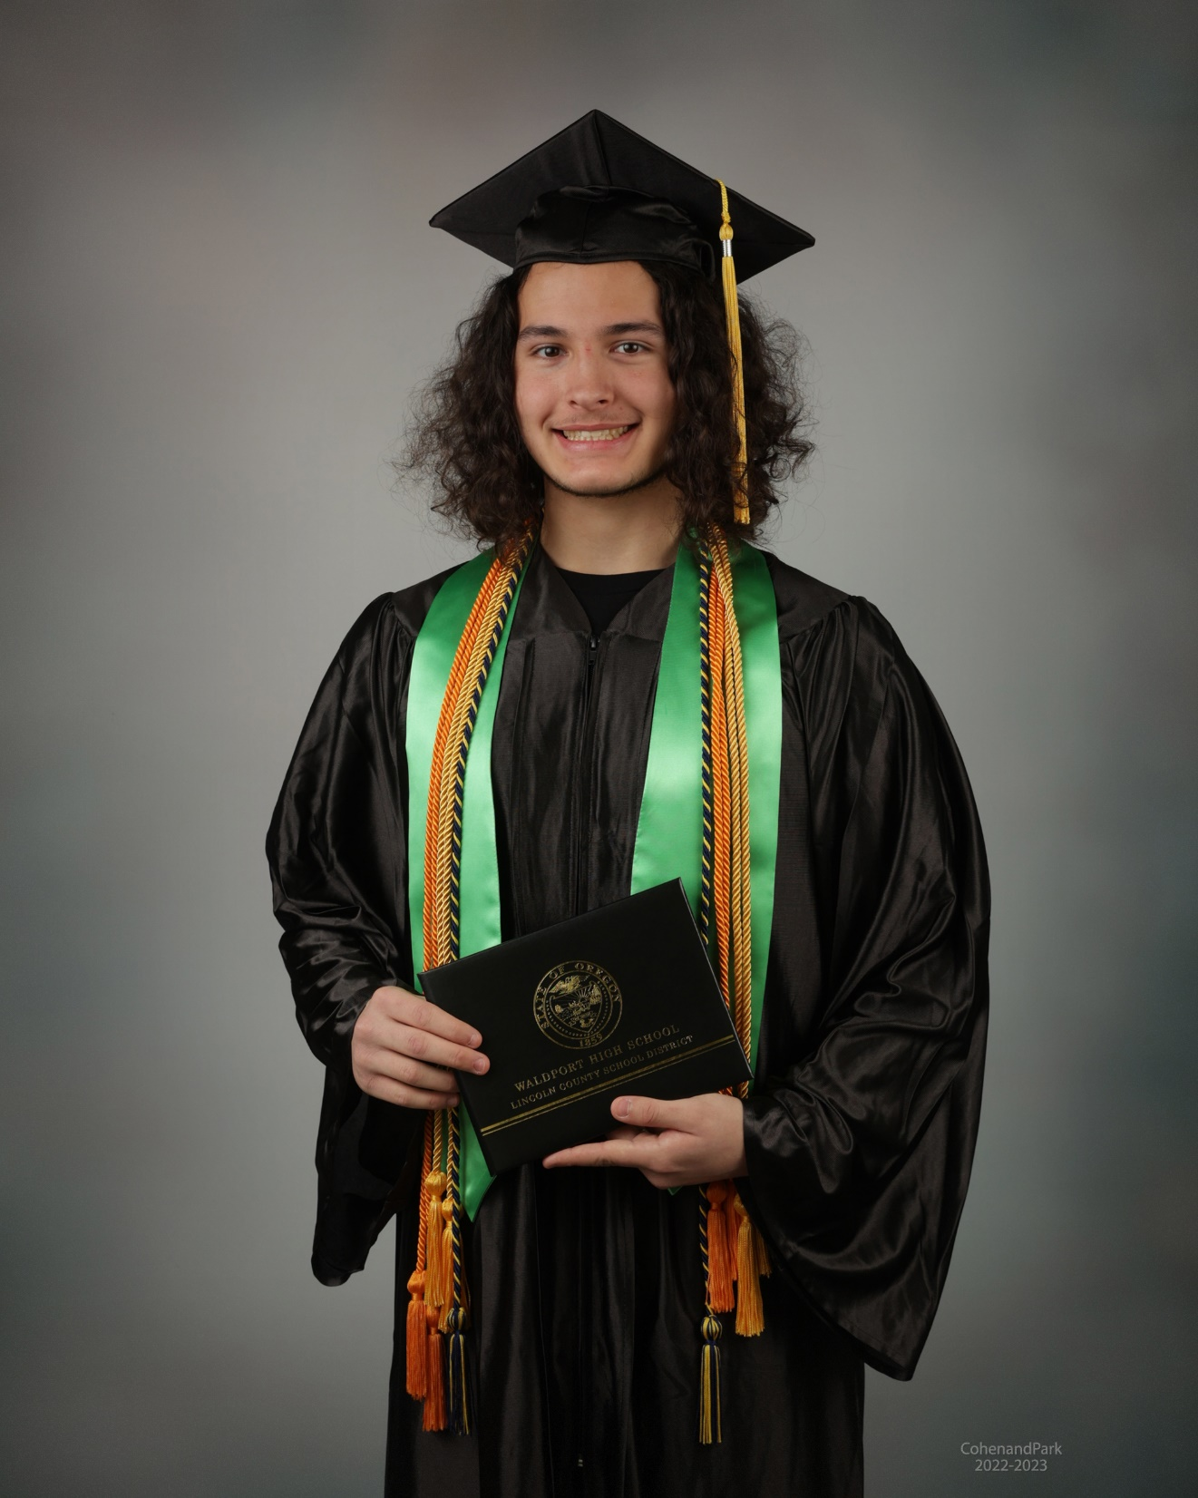
Valour Samuel Jones
Honors Diploma
Salutatorian
Valour will attend Oregon Coast Community College to study Nursing. He will continue his studies with OCCC and OHSU to earn his BSN.

Slide 17
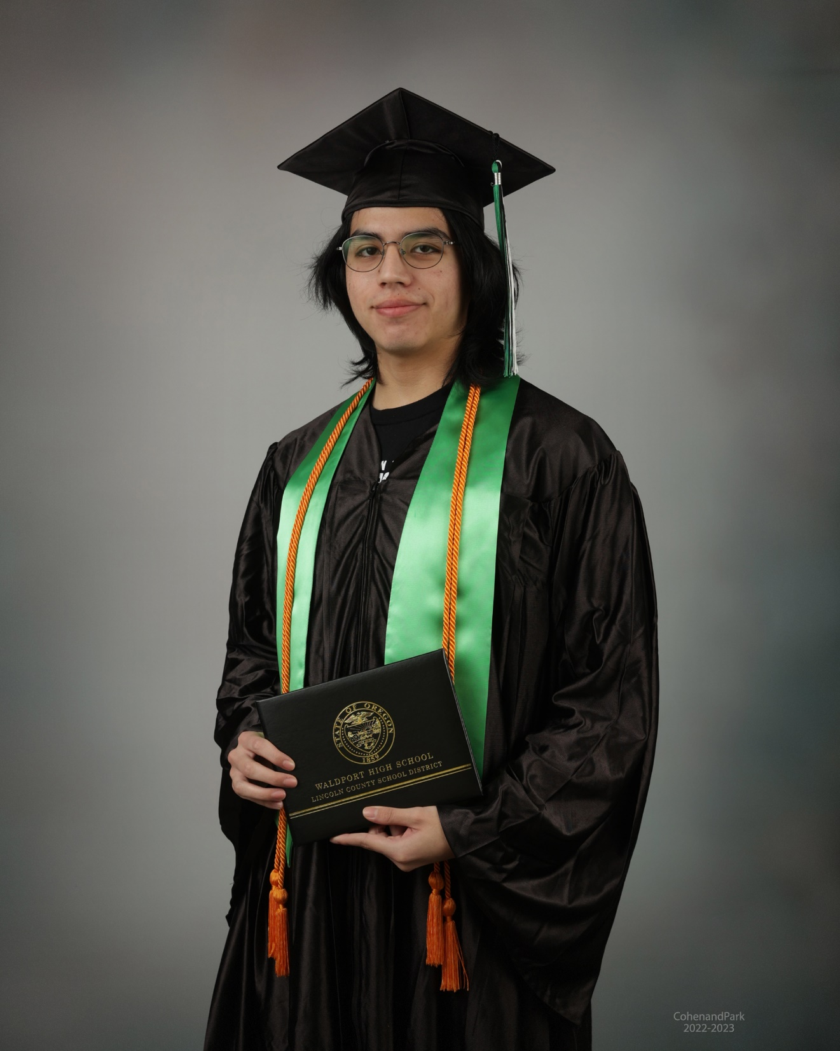
Oscar Benjamin Juarez
Oscar will be attending Oregon Coast Community College after graduation. His long term goal is to work as a weapons engineer.

Slide 18
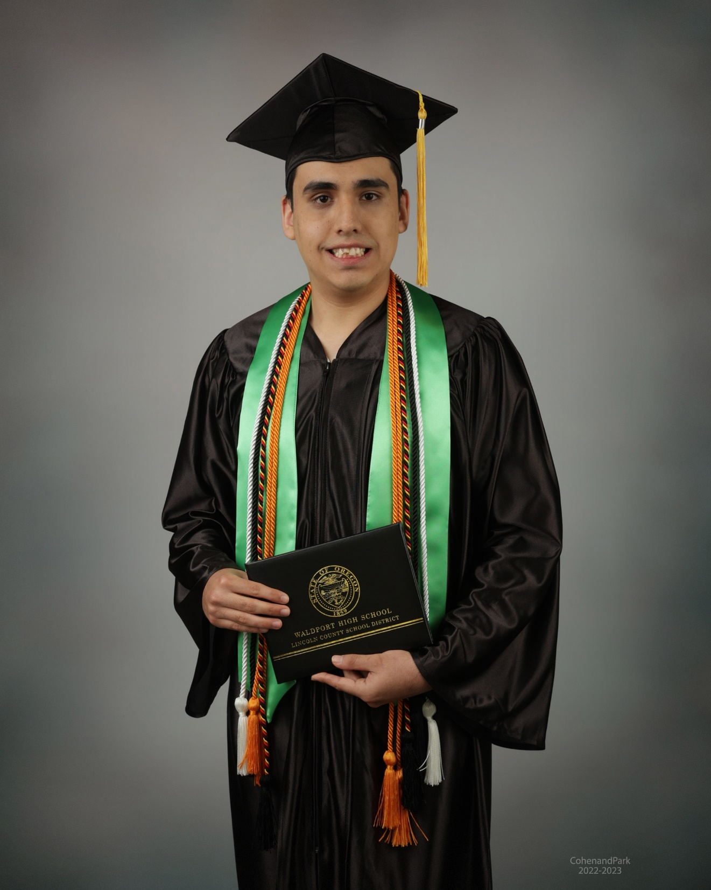
Alexavier King
Alex will be continuing his education next year in the transition program at NHS.
His future plans are to gain employment in the service industry.

Slide 19
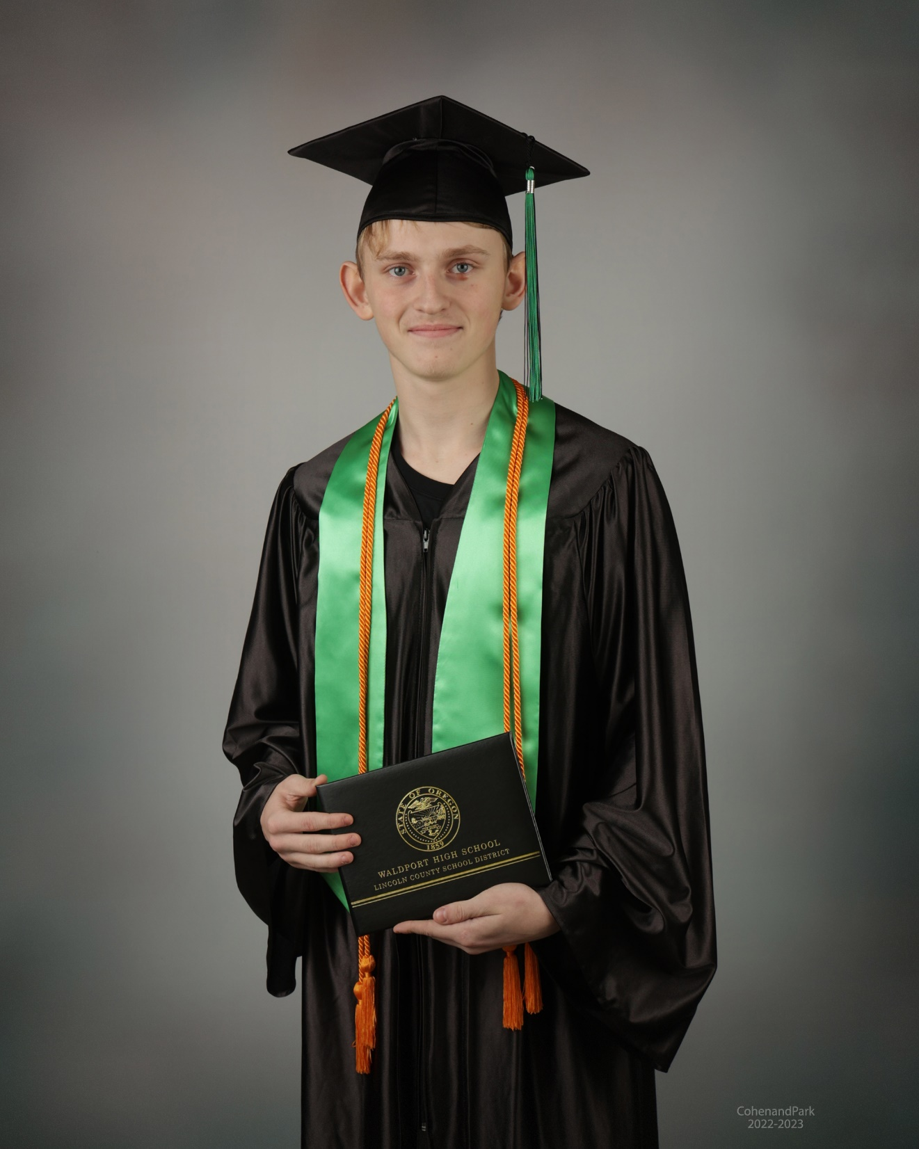
Triston E. Lupardes
Triston plans to work after he graduates. His long term goal is go to college and earn a degree in Business while fishing. He plans to start his own business in the future.

Slide 20
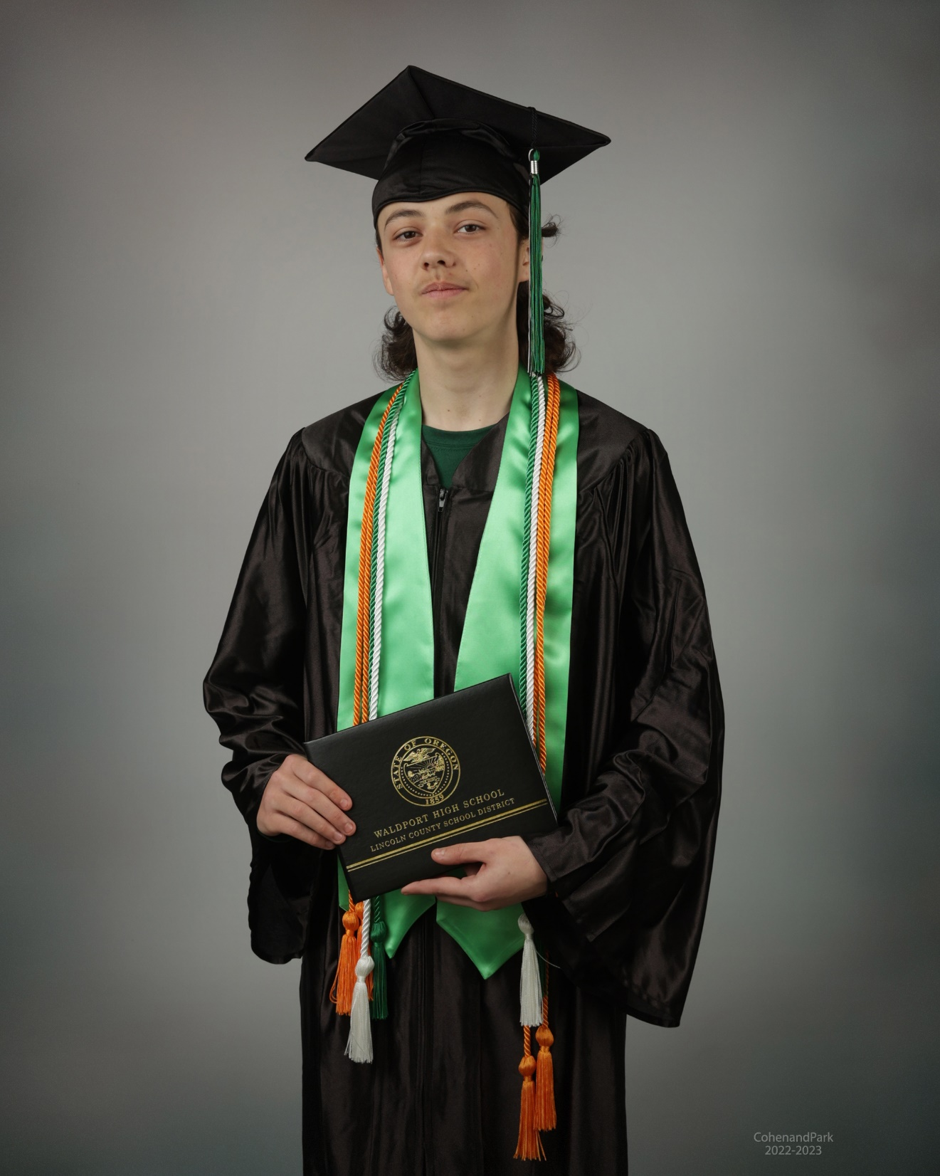
Adam Lee MacFarlane, Jr.
A.J. will be attending Oregon State University. He will be majoring in History. His long term goal is to become a history teacher and a
basketball coach.

Slide 21
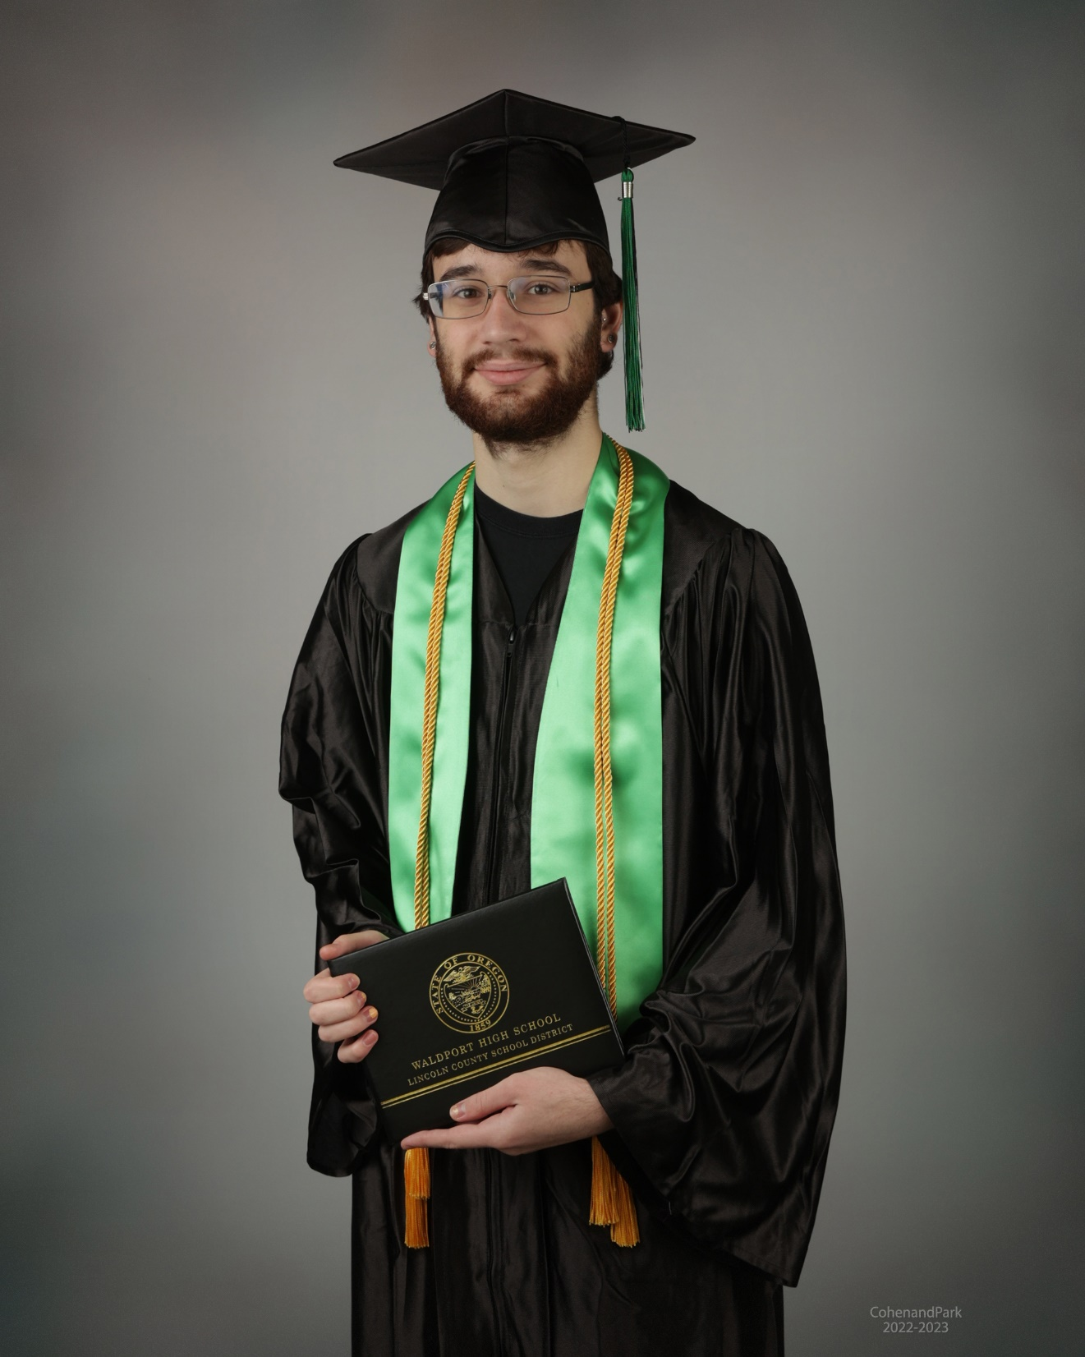
Liam J. Morgan
Liam will be attending Oregon State University in the Fall. His long term plans include a career in entomology.

Slide 22
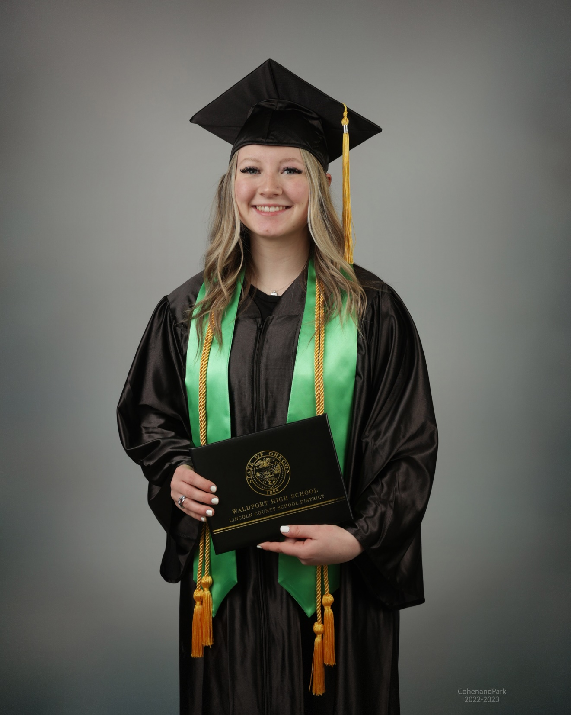
Kathryn M. Pankey
Katie plans to attend Linn-Benton Community College after graduation. She will be studying to become a dental hygienist.

Slide 23
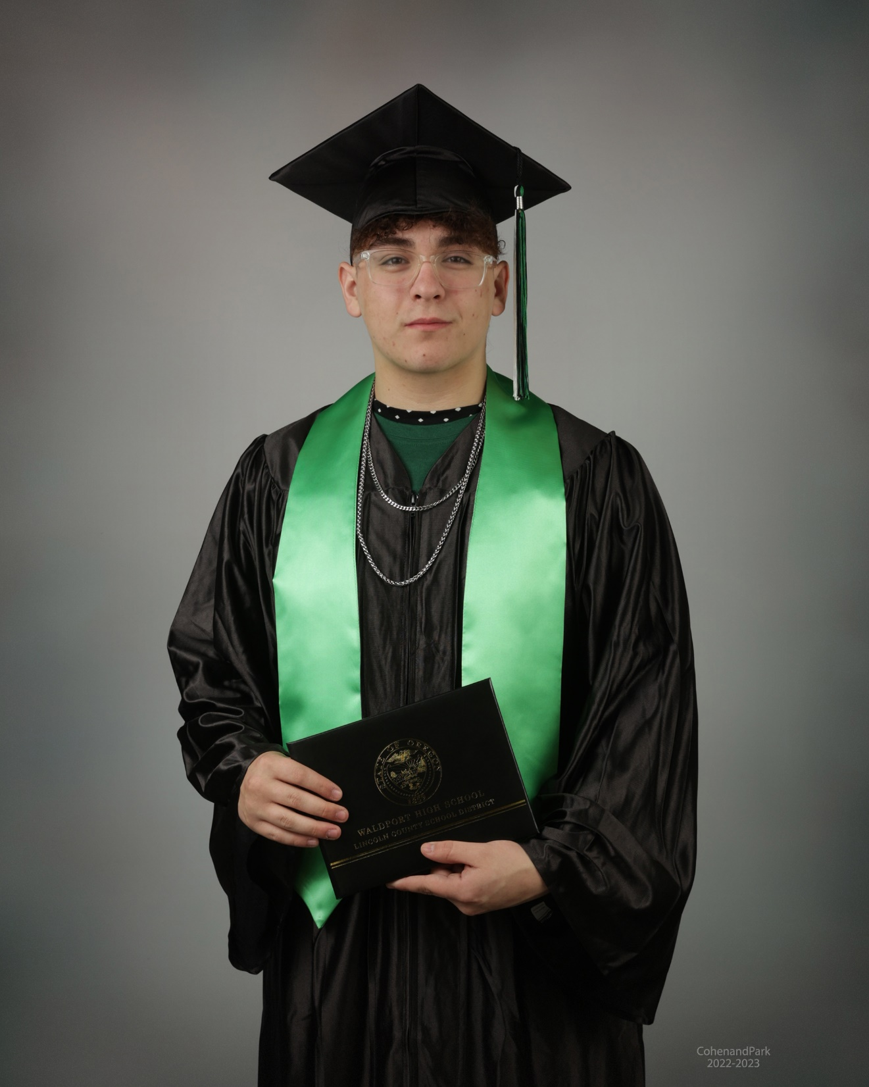
Kaden R. Parker
Kaden will be attending Linn-Benton Community College after graduation. He will major in business with the goal to start his own business in the future.

Slide 24
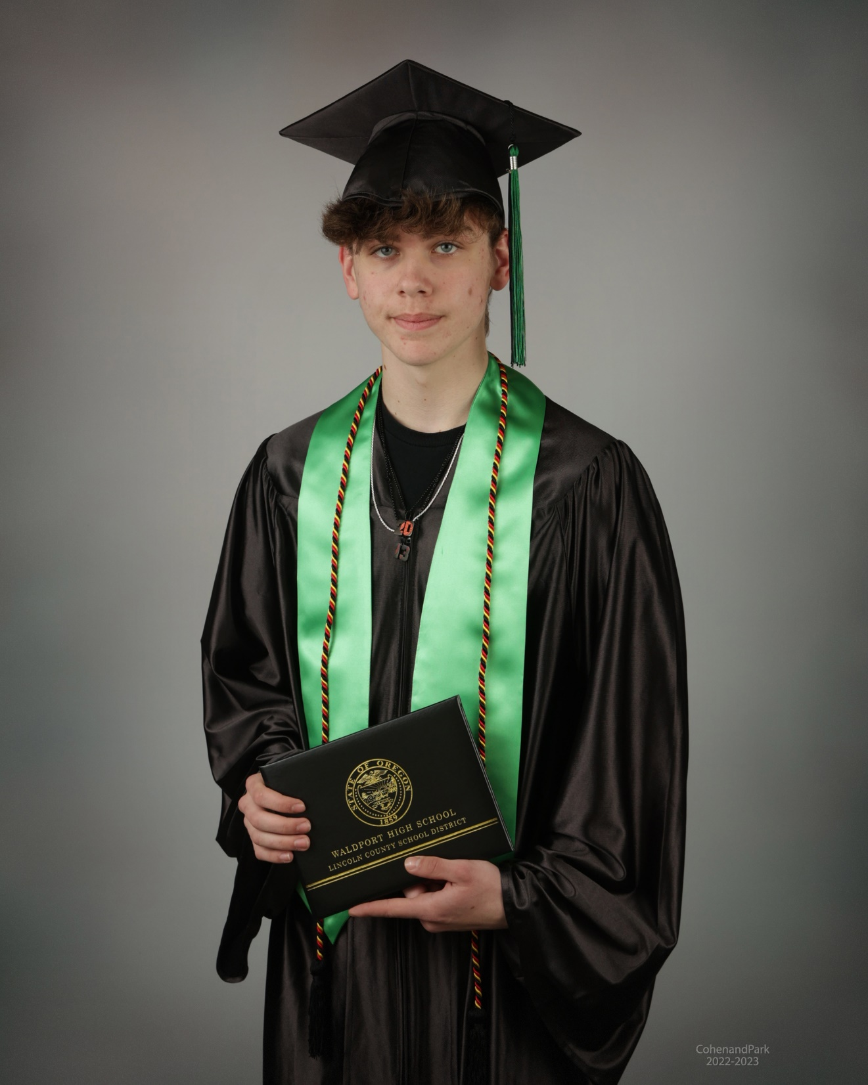
Hunter A. Postma
Hunter will be entering the workforce after graduation. He plans to work his way up to a management position.

Slide 25
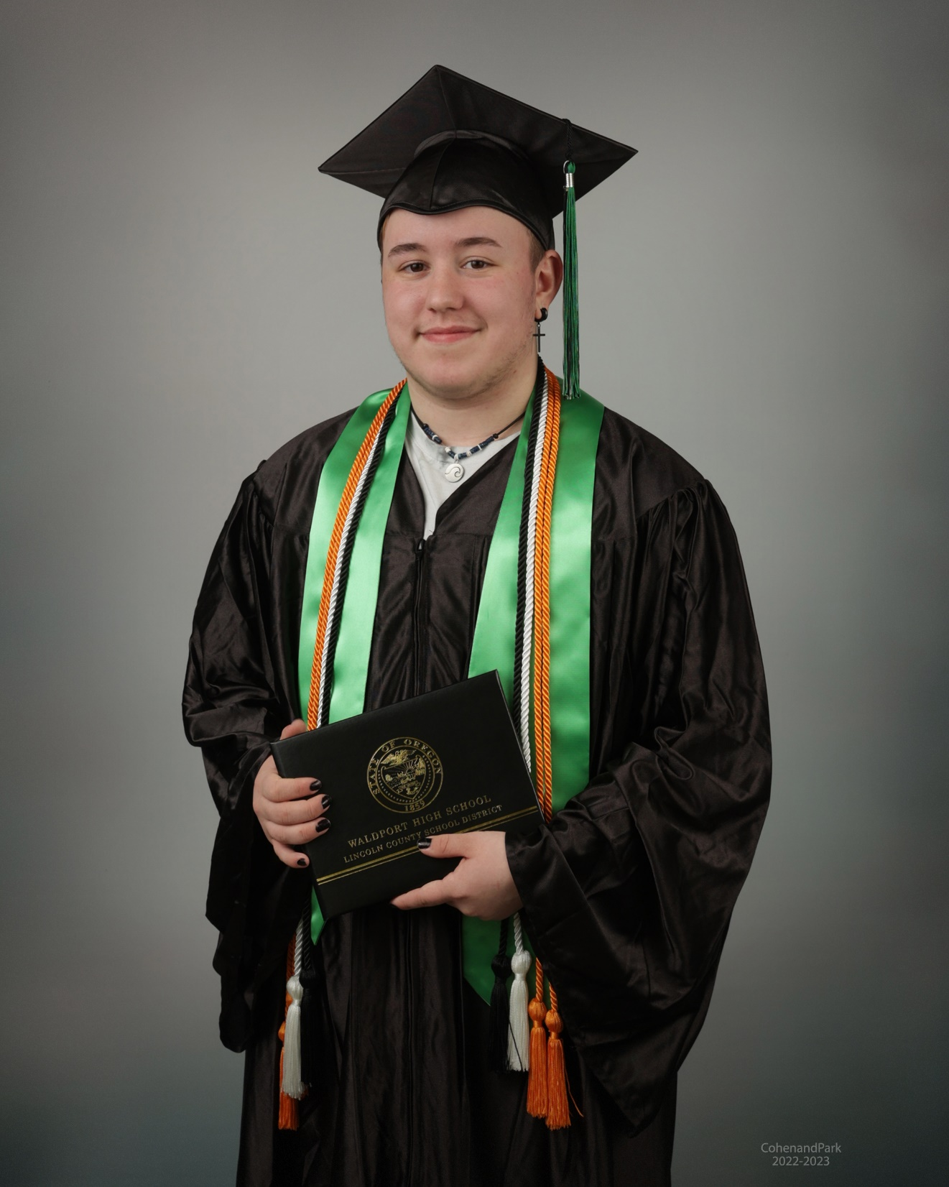
Jory Marcus Reed
Jory will be attending Western Oregon University as a criminal justice major. Jory’s long term goal is to pursue a career in law enforcement special ops as a K-9 handler.

Slide 26
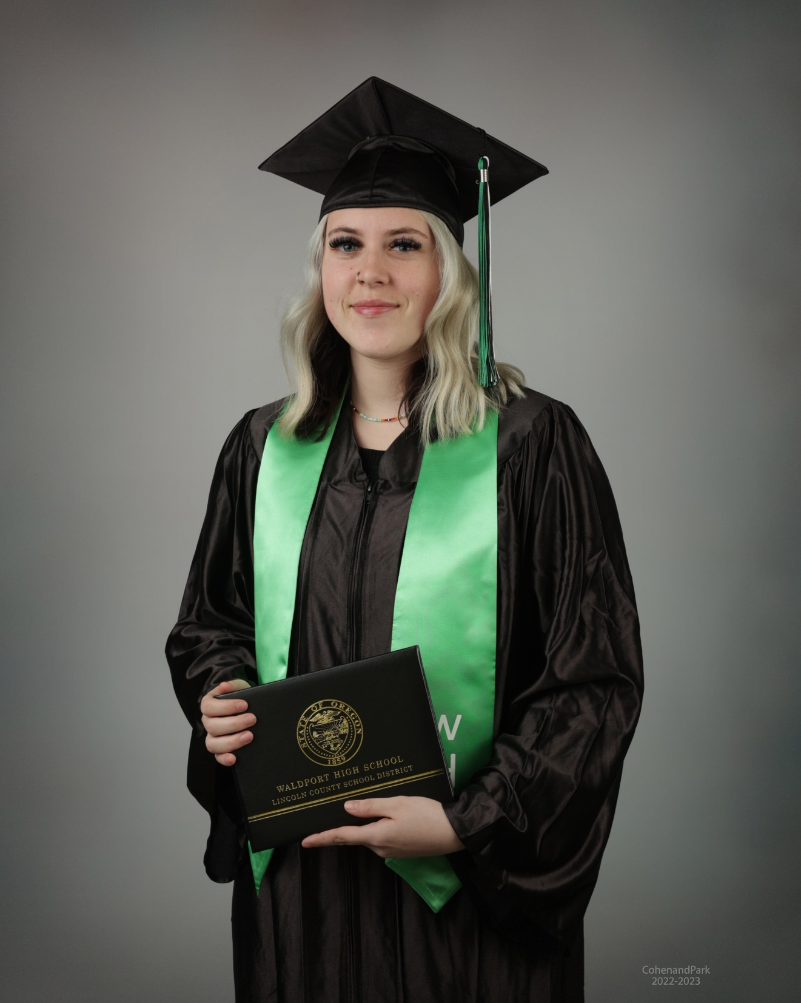
Cayden R. Ritchey
Cayden will be attending Linn-Benton Community College after graduation. Her goal is to become an ultrasound technician.

Slide 27
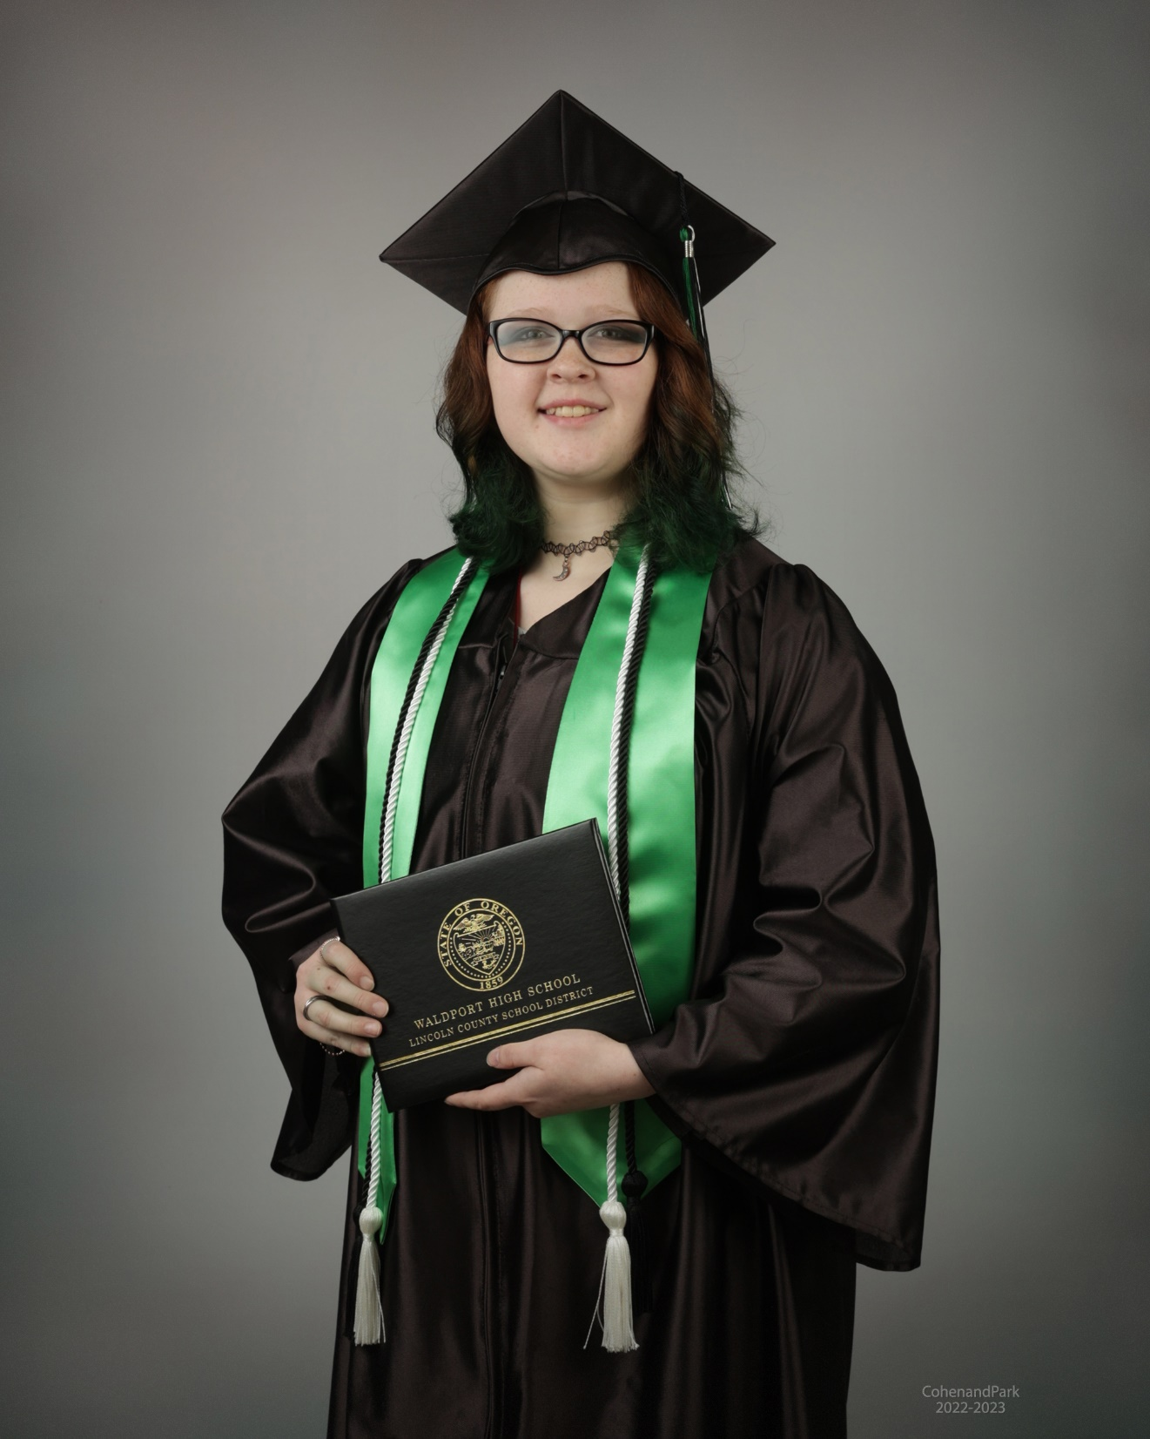
Remy R. Ritchey
Remy plans to attend an Oregon Community College after graduation with a long term goal of starting their own coffee business.

Slide 28
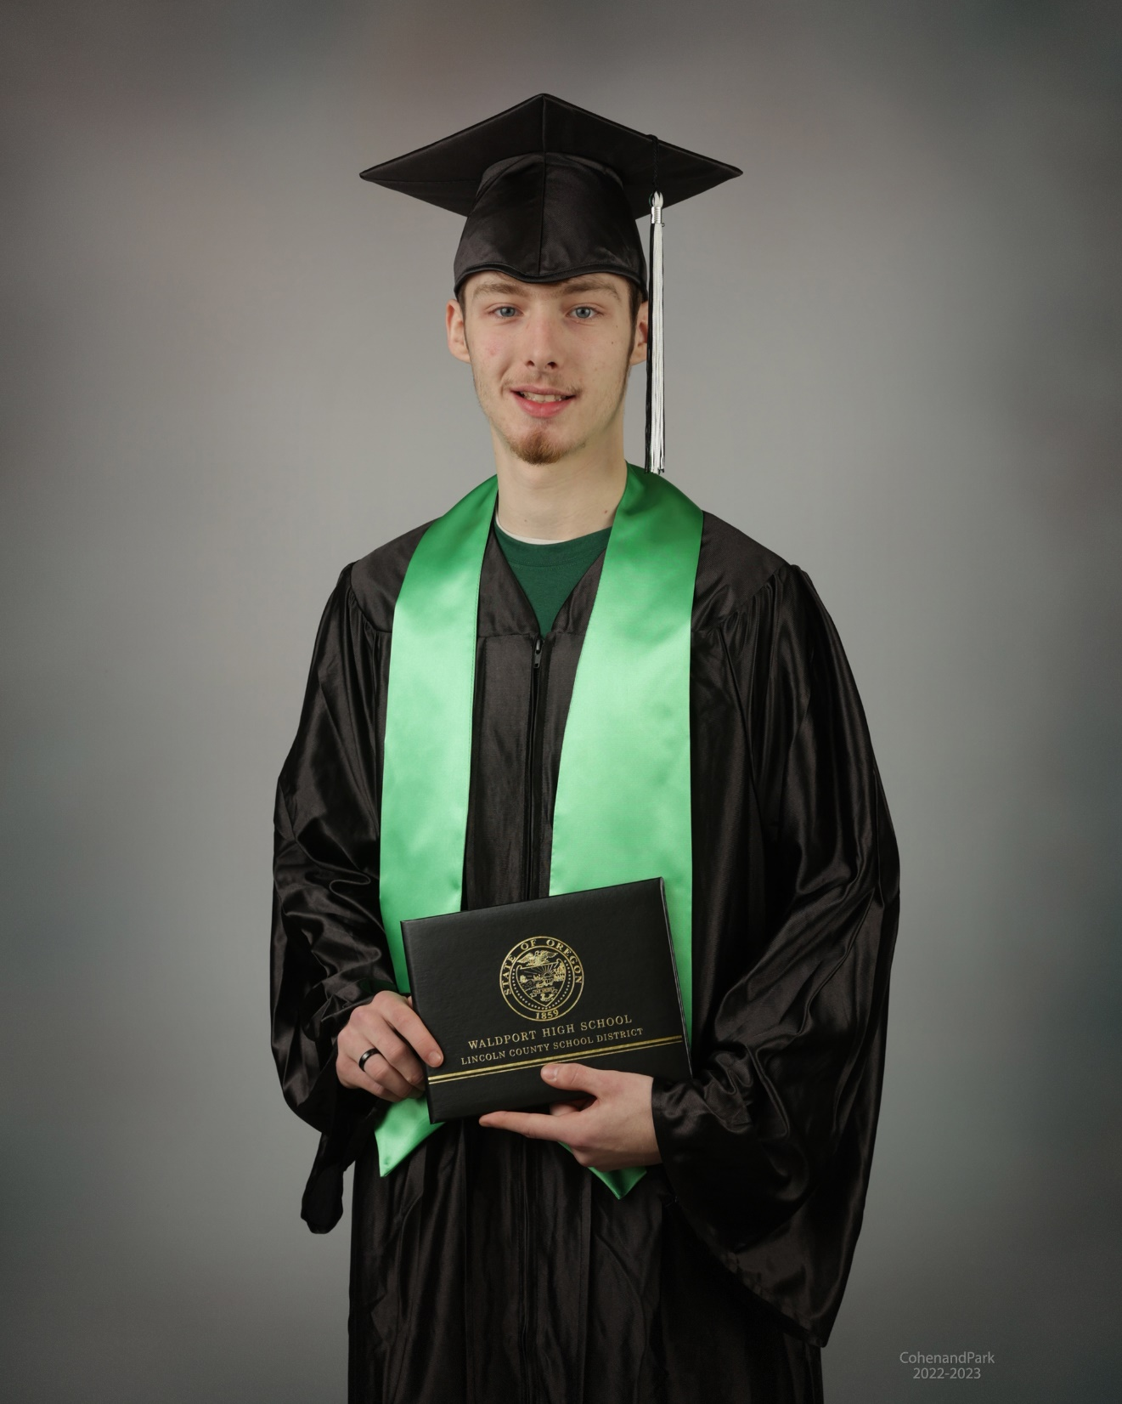
Dulton J. Rodgers
Dulton will be working in construction and later joining the Army National Guard.

Slide 29
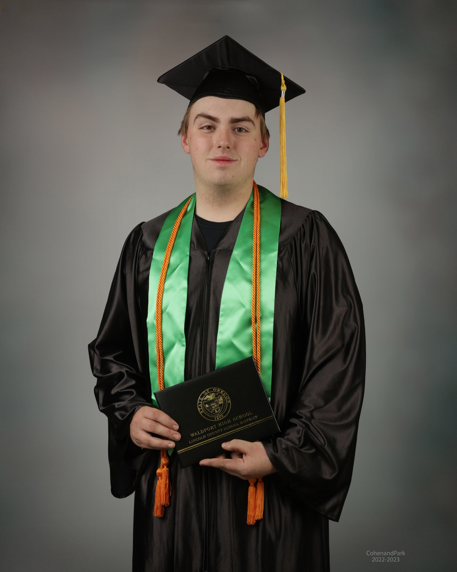
Eli J. Spangrud
Eli will be attending Northwest Lineman’s College in Idaho after graduation. His long term goal is to become trained and employed as an electrical lineman.

Slide 30
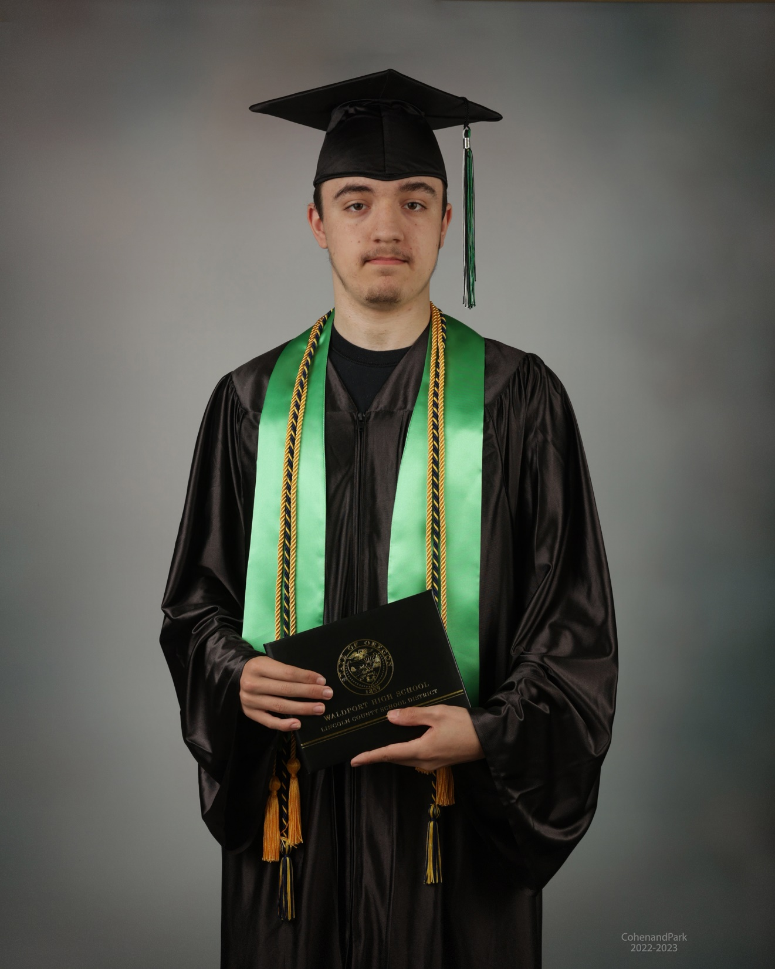
William S.Thaler
William will be attending Oregon State University in the fall majoring in Computer Science with a goal to start his own gaming industry. He was awarded the Oregon Opportunity Grant and a Federal FSEOG Grant.

Slide 31
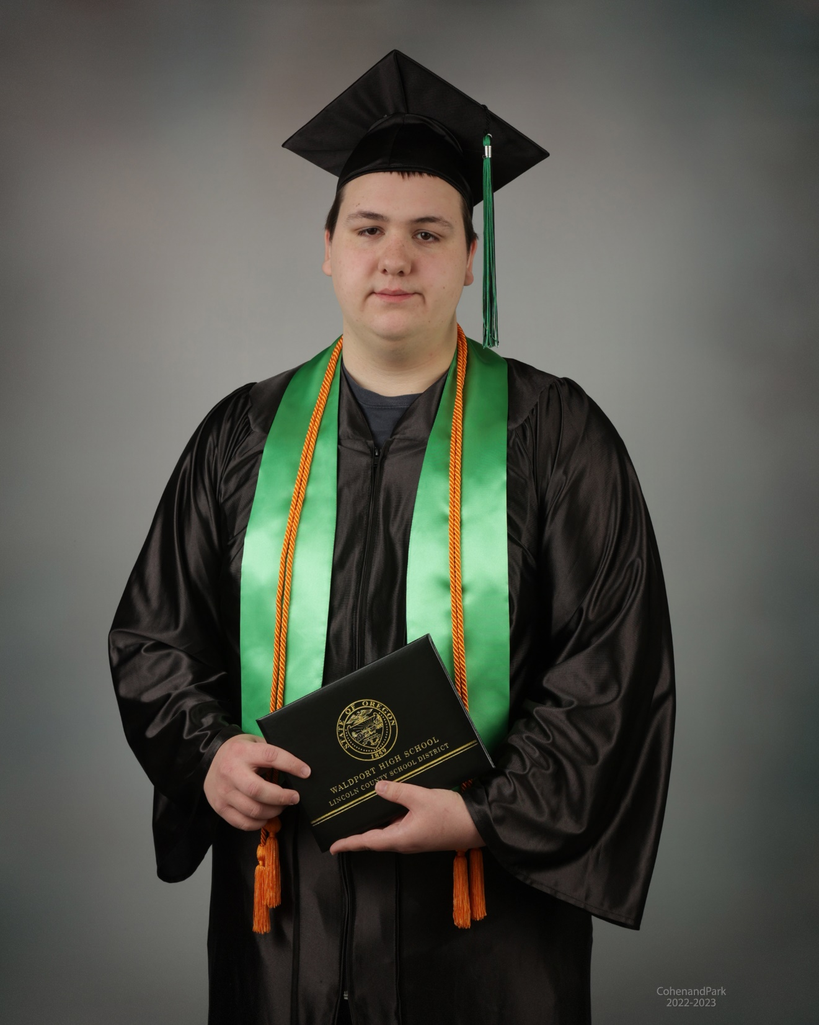
Eli W. Thomas
Eli completed his graduation requirements in January 2023! He is currently attending JobCorps training to be a mechanic.

Slide 32
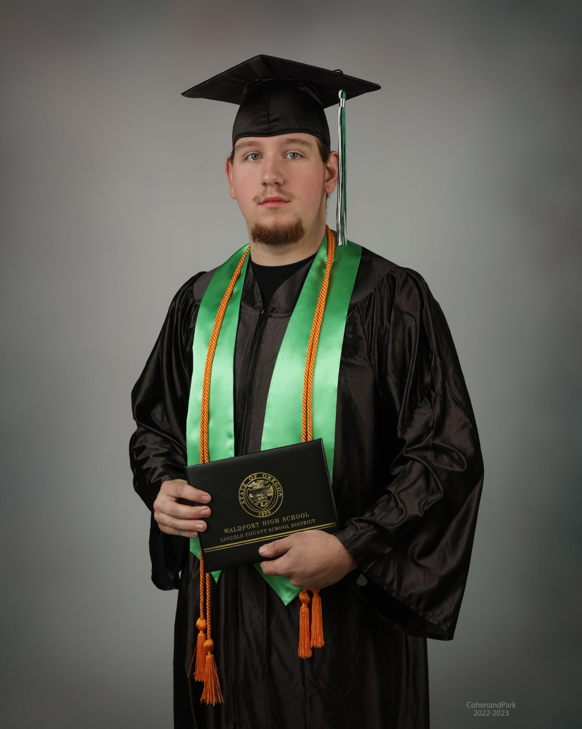
Jake E. Turkaly
Jake will be starting his forestry career after graduation with the Oregon Department of Forestry as a wildland firefighter.

Slide 33
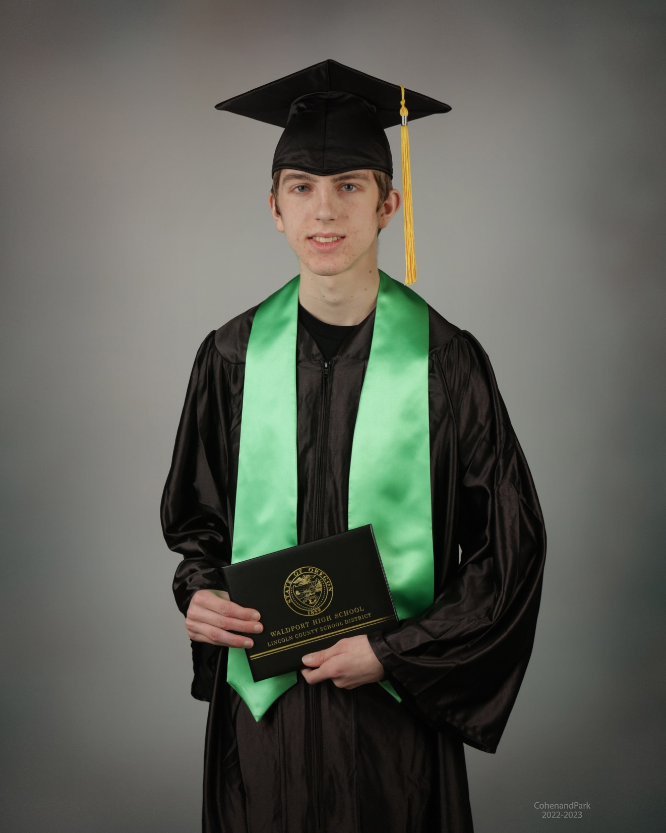
Levi A. Von Dallwitz
Levi’s future plans after graduation include enjoying his summer and then gaining full-time employment.

